Slide 1
Memory Leak & Libraries
Someswara Rao

Slide 2
Objective:
What is Memory Leak?
How to check Memory Leaks?
Causes on Memory Leak
What is Library?
Static Library
Shared Library
Building our own libraries

Slide 3

What is Memory Leak ?
Memory page frames which are allocated to the process and later unused by the same process and yet unavilable to be allocated by the kernal.
A failure in a program to release discarded memory,
causing impaired performance or failure.

Slide 4
Check Memory Leaks ( Valgrind )
Valgrind is one of the tools that are used to check the Memory Leaks.
This is a memory mismanagement detector which not only checks Memory Leaks but also deallocation errors.
This is a wrapper around the collection of tools that do many other things focusing especially on memcheck.

Slide 5
Useful options for memory check.
--leak-check=no|summary|full
[default: summary] : Valgrind tracks all memory block allocations. When the program finishes it prints which blocks have not been freed. The option full shows a lot of detail.
--show--reachable=no|yes
[default: no] : Print some information about blocks of memory not deallocated. but which have references.
--track-origins=no|yes
[default: no] : Show origins of undefined values or not

Slide 6
Causes of Memory Leaks
Using undefined values, i.e. values that have not been initialised, or that have been derived from other undefined values.
Incorrect freeing of heap memory, such as double-freeing heap blocks
Not freeing Memory for Allocated Memory
Use of uninitialized or unaddressable values in system calls.
Reading or writing freed memory.

Slide 7
C Std Library:
libc
static
shared
libc.a
libc.so
Compiled and assembled
Compiled and linked

Slide 8
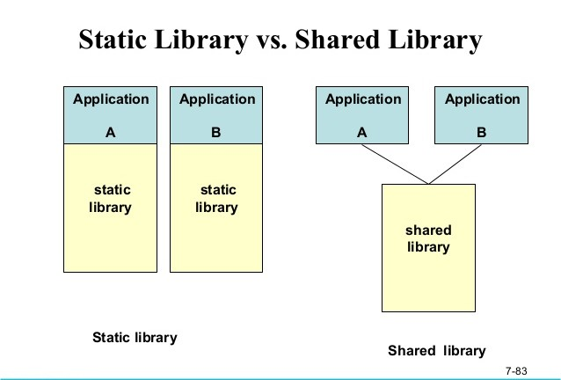
Static Linking vs. Dynamic Linking:

Slide 9
Building our own libraries:
Building static library :
compile library files
$ ar -crU -o libmathops.a a.o b.o
$ gcc -static -o static app.c -I./ -L./ libmathops.a
Building shared library :
compile library files
$ gcc -shared a.o b.o -o libmathops.so
$ export LD_LIBRARY_PATH=$LD_LIBRARY_PATH:./
$ gcc -o shared app.c -I./ -L./ libmathops.so

